Slide 1

Damnatio

Slide 2
“Unleash Damnation.”
Bound within these darkened halls, wield thy forbidden relics and summon creatures of malice to cleave through the damned—until thou art called to face the demon whose rite bars thy escape.

Slide 3
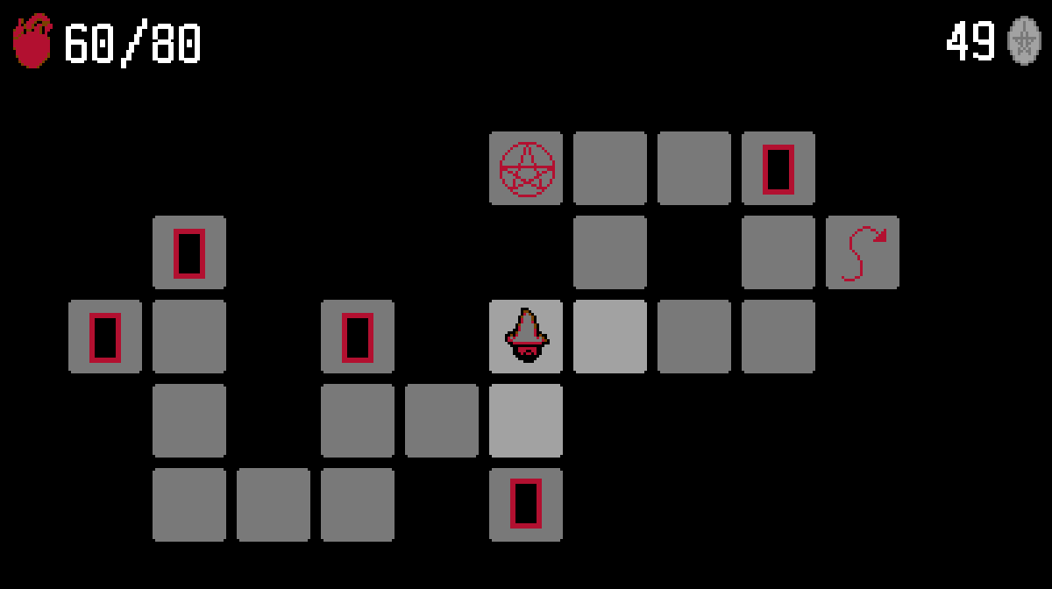
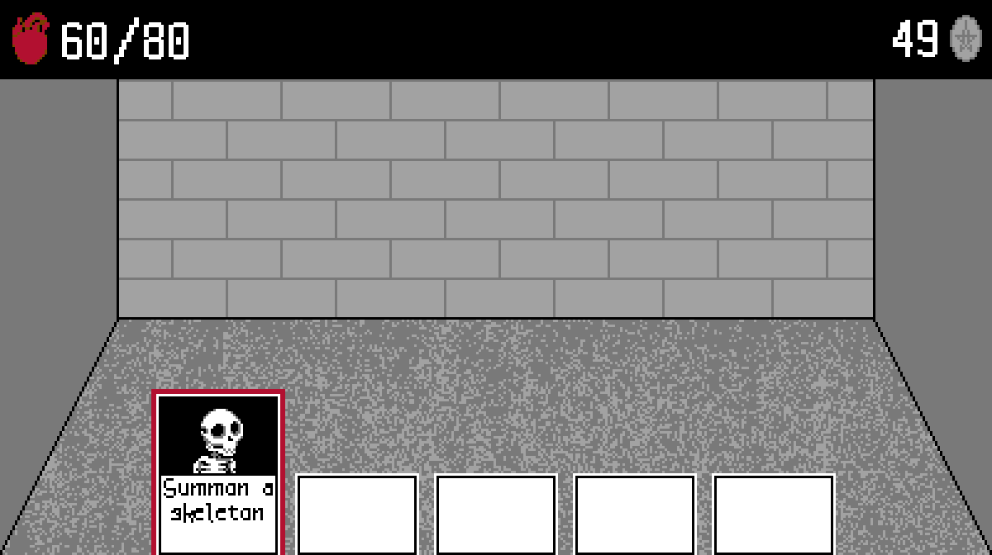
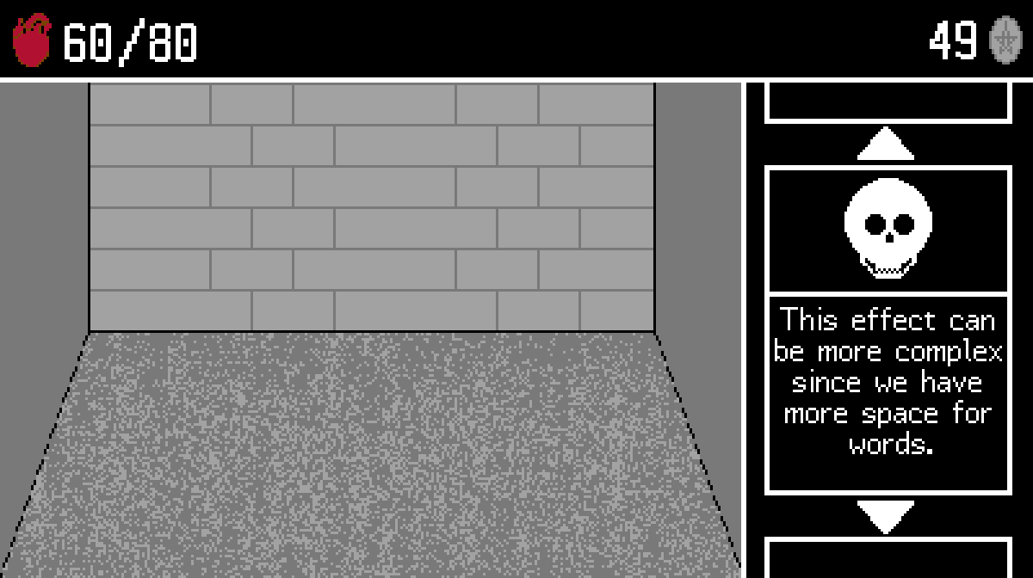
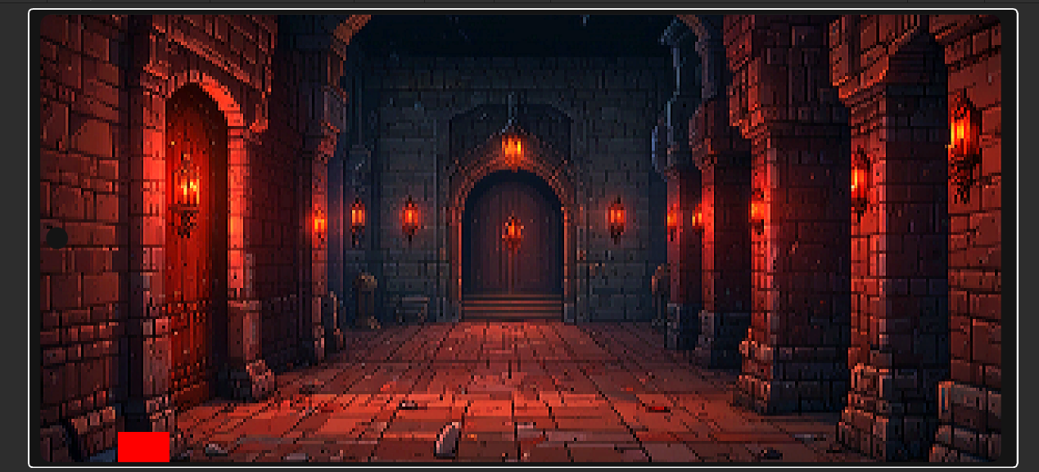
Concept Art

Slide 4




Technical Choices

Slide 5
Team Composition
Role: Project Manager
Technical Expertise:
Organisation
Strategization
Time-keeping
Keen eye for detail
Michael

Slide 6
Team Composition
Role: Technical Lead
Technical Expertise:
Abstract understanding of overall system
Explore different technical techniques
Experiment with code
Ozzy

Slide 7
Team Composition
Role: QA + UX Guru
Technical Expertise:
Devising test plans
User Testing
Functional Testing
Unit Testing
UX design
Documentation
Myles

Slide 8
Any questions?
Thank you for listening!

